Slide 1
Scheduling of Patrols Within the UPLB Campus Using an Opportunistic Crime Security Game
Karl Jasson B. Pios and Jaderick P. Pabico

Slide 2
Introduction
Patrolling is one of the most common practices done by security entities
There are two challenges faced when deploying patrols
Limitations to resources, as full coverage is costly
Patrol movements can be observed by enemies, and avoiding predictability is a must
Notes:
Background of the study

Slide 3
Introduction
Randomization of patrol movements can help against predictability, but full dependence on pure randomization causes inconsistencies.
Higher priority areas may not be visited sufficiently
Several areas may receive too few or too many visits day by day
Randomization cannot be effectively executed by human subjects without assistance.
Patrols ordered to “move randomly” are still susceptible to personal biases, and patterns may still develop patterns
Notes:
Statement (2/2)

Slide 4
Introduction
This study aims to assist the UPLB University Police Force in deploying patrols optimally within the campus.
A scheduling program is developed that addresses the following:
Deploy patrols randomly, but with weighted probabilities (high priority areas get higher probabilities)
Create patrolling schedules that make it harder for enemies to predict patrol movements
Notes:
Significance of the study

Slide 5
Review of Literature
Stackelberg Security Games (SSGs)
Leader/defender constantly deploys patrols to protect targets, knowing that followers/attackers are observing and are planning an attack
When patrol movements are more difficult to predict, attackers will find it harder to figure out when and where to attack

Slide 6
Review of Literature
Three categories of SSGs:
Infrastructure security games (organized crime, terrorist attacks)
Green security games (poachers, illegal loggers, illegal fishing)
Opportunistic crime security games (urban crime)

Slide 7
Review of Literature
Primary challenges of SSGs:
Scalability (complexity increases as the amount of resources and targets increase)
Robustness (assumptions may be inaccurate, researches often adjust the algorithm using obtained data)
Bounded Rationality (adversaries are not perfectly rational, not selecting the optimal strategy as assumed by game theory)

Slide 8
Review of Literature
Opportunistic Crime Security Games
Crimes occurring in public areas, such as UPLB, are considered opportunistic
Criminals do not plan ahead, instead they commit crime when they see a chance
Crime data can be used to in planning and adapting the security entity’s strategy, prioritizing areas with higher crime rates
If criminals perceive a greater risk, they are often discouraged from committing crime

Slide 9
Materials and Methods
Software used for this research
Java 11
Eclipse Integrated Development Environment (IDE) version 2020-12

Slide 10
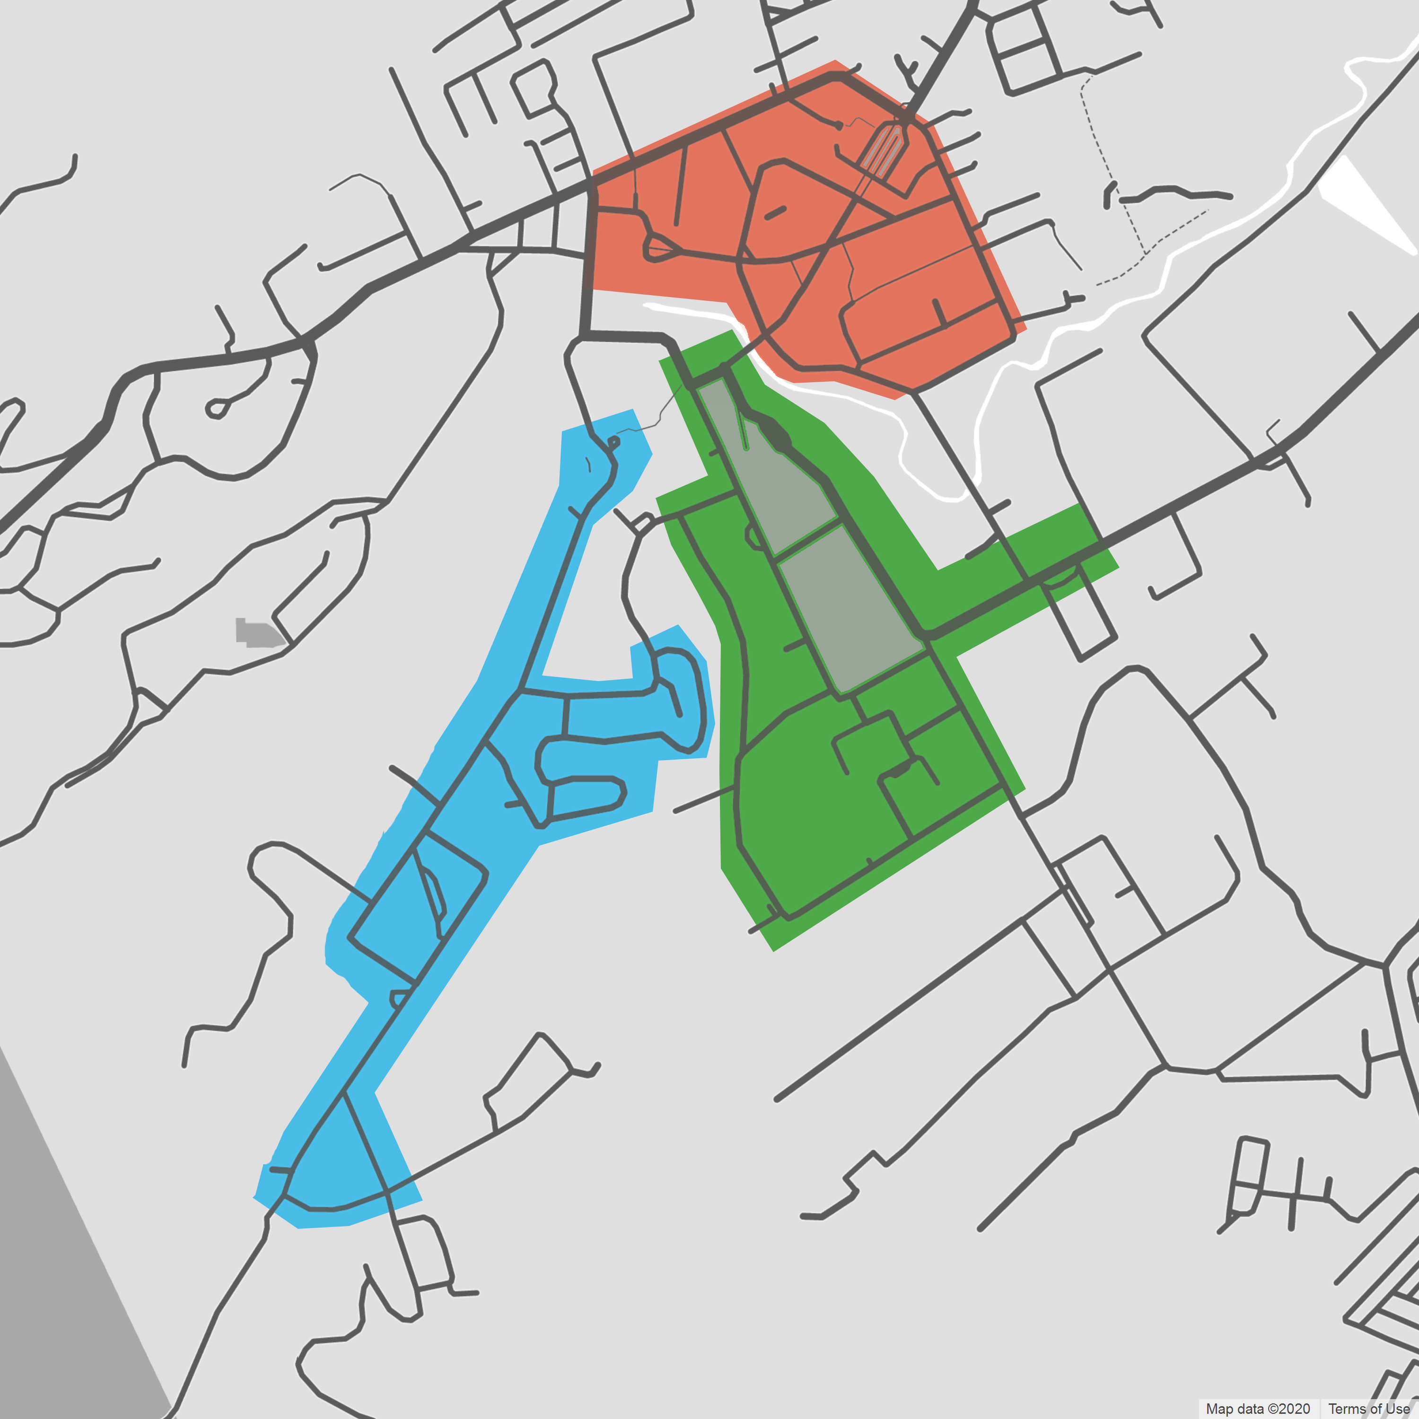
Materials and Methods
The campus is divided into 3 zones, and each zone into patches
User sets the schedule length, interval length and the number of patrols deployed in each zone
Each patrol only moves within the zone they’re assigned to, except during emergencies.
Zoning ensures patrols are spread fairly well across campus

Slide 11
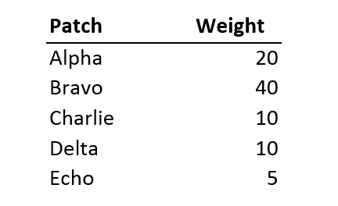
Materials and Methods
Patches have “weight” values, determined by their priority level
Each zone has its own probability distribution influenced by the weights of the patch they contain
A patch’s probability is determined by its weight divided by the sum of all weights in the zone

Slide 12
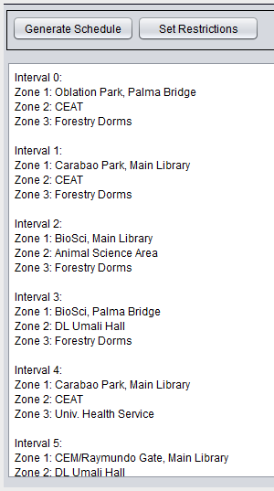
Materials and Methods
For each zone, in between intervals, the scheduling program selects patches equal to the number of patrols in the zone.
A patch may be selected for consecutive patches
More patrols in each zone improve coverage

Slide 13
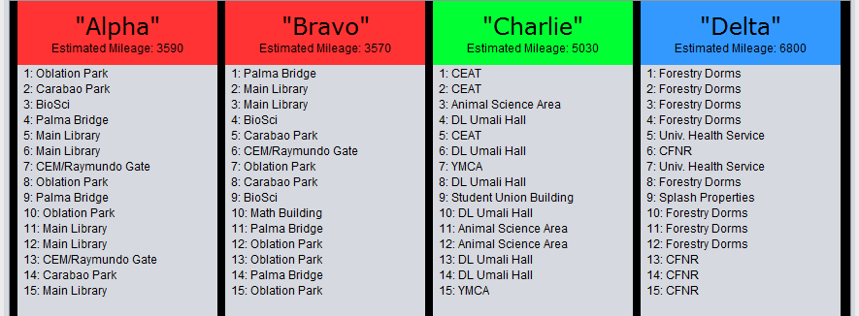
Materials and Methods
Each patrol has an estimated “mileage” value that calculates how far said patrol has travelled
When assigning which patrol to visit what patch, the program aims to keep the average mileage low (each zone gets an exclusive average mileage)

Slide 14
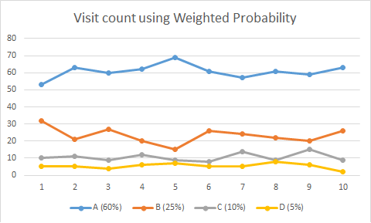
Results and Discussion
The effectiveness of the scheduler increases as the number of patrols increase.
The scheduler kept visit frequencies consistent, and higher priority areas are sufficiently visited
Attackers may observe how often an area is visited, but not predict when the visits occur

Slide 15
Results and Discussion
Comparing the schedulers output to a system using Uniform Randomization shows that weighed probability is more effective
Visit frequencies were nearly equal to each other, which in the real world, would be inefficient
Comparisons to unaided human decision making could not be conducted as information on current patrol strategies was confidential.

Slide 16
Results and Discussion
The zoning approach has provided several limitations
Inability to transfer patrols between zones midway
Patrols still have a tendency to cluster in one area of the zone
Zones with zero assigned patrols are unguarded for the duration of the generated schedule
Long duration schedules cannot be generated properly as patrols have no way to reset mileage values, which would have reflected personnel replacements/shifts.
It is possible to keep the average mileage lower if the scheduler can look ahead into the schedule when assigning patrols.

Slide 17
Conclusion and Future Work
This scheduler is capable of deploying patrols around the campus while avoiding predictability
High priority areas are ensured a sufficient amount of visits, while lower priority areas will not be neglected.
Implementations on zoning, scheduling, and assignment can still be improved by more dynamic approaches

Slide 18
Conclusion and Future Work
Real-time data on patrol locations would improve the scheduler’s algorithm, which can be obtained by simulation integrated into the system itself, or real world GPS data.
Future studies may look into larger domains with different constraints and environments, such as subdivisions or public events.

